Slide 1

78. BookShelfX: Digital Library Rental
NANDINI KIRAN SOLANKI
150096725189

Slide 2

Index
Problem Statement
Your solution
Working (Method/Mind map)
Conclusion.
.

Slide 3
PROBLEM STATEMENT
Heading: Project Overview: BookShelfX
The Concept: A modern digital library rental platform designed to bridge the gap between traditional libraries and digital accessibility.
The Mission: To provide a seamless, structured environment for users to browse, learn about authors, and rent eBooks.
Target Features:
Curated catalog of 40–45 books.
Grid-based UI with a warm-tone color theme and "Doto" typography.
Interactive rental tracking via JavaScript.

Slide 4
SOLUTION
Heading: The BookShelfX Experience
Smart Navigation: Five-page architecture including a Video-Hero homepage and a dedicated Authors profile section.
The Digital Catalog: Responsive grid layout with interactive hover effects.
Sidebar filtering by genre, rating, and price.
Deep Dive Details: Individual book pages featuring descriptions, "Read Sample" links, and instant rental options.
User Library: A personalized space to manage rented titles and track active reading sessions.

Slide 5
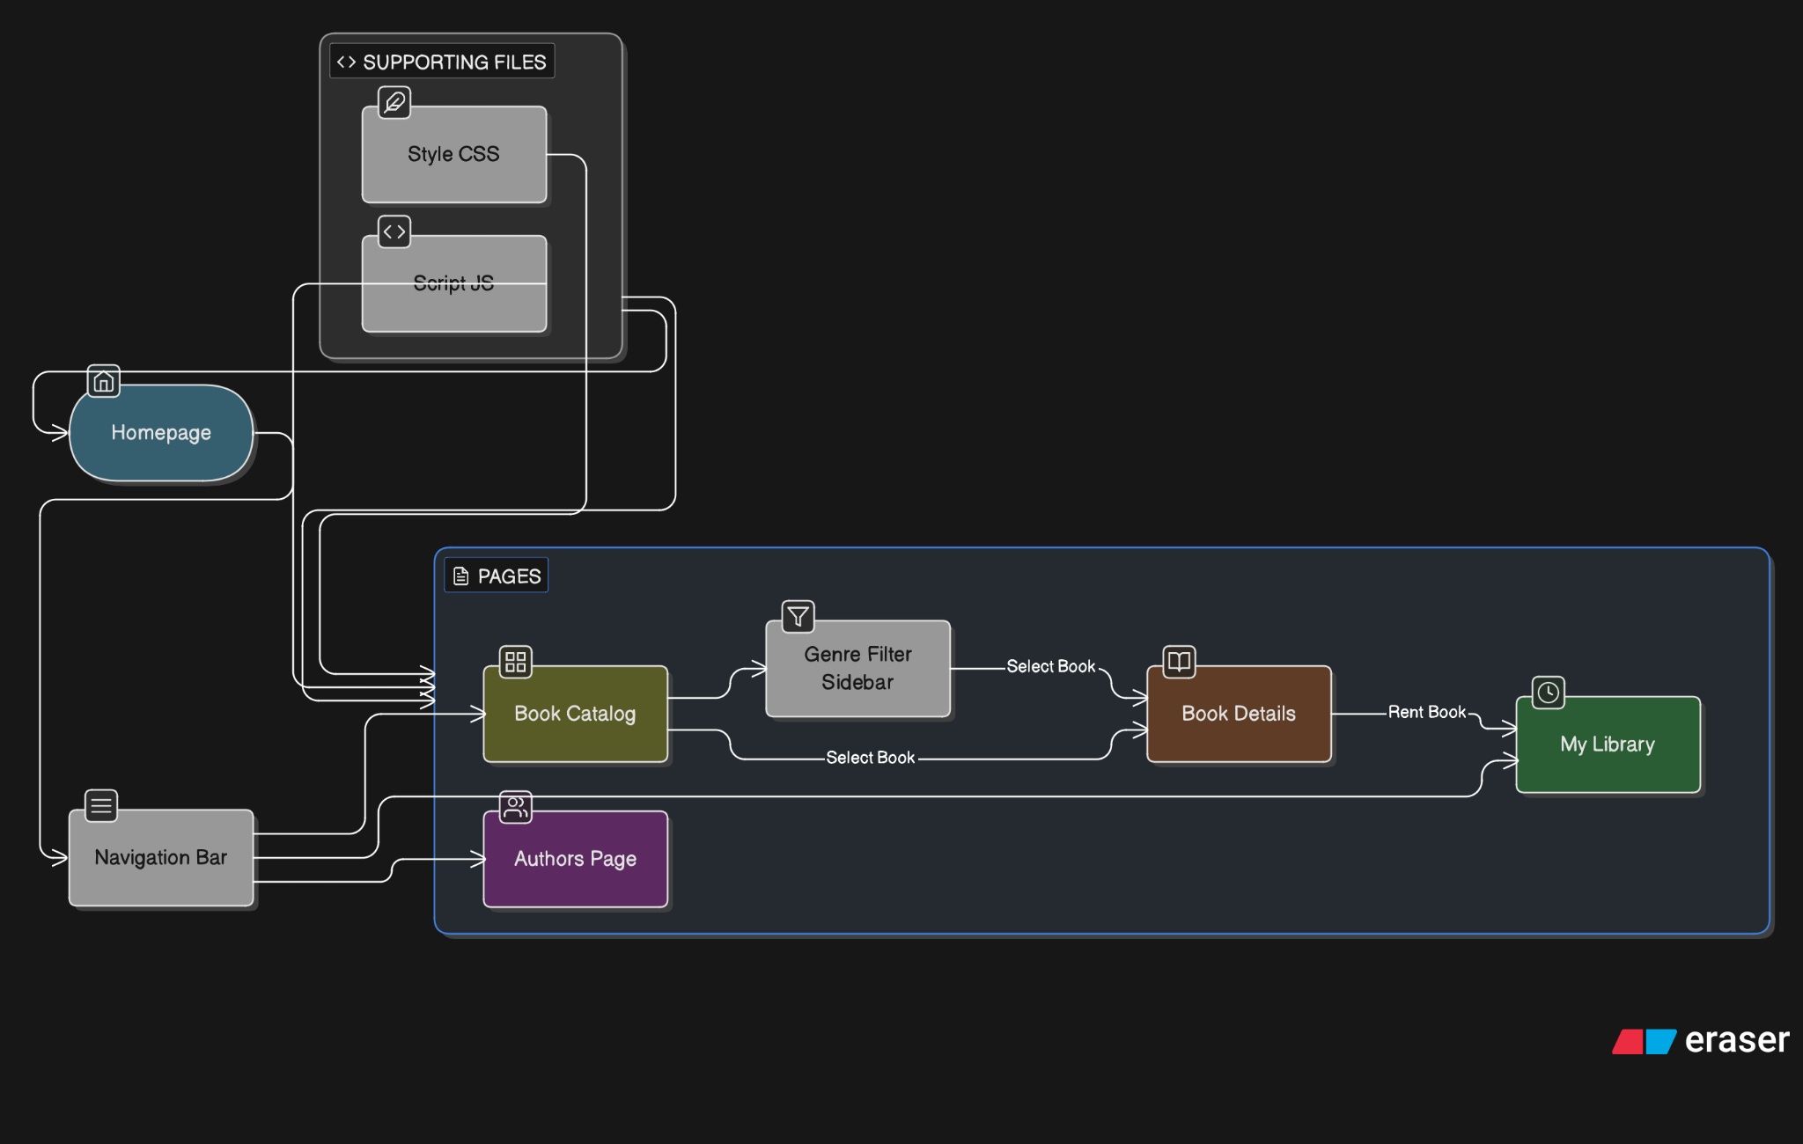
WORKING (Method/Mind map)

Slide 6
CONCLUSION
Heading: Project Outcomes & Future Scope
Key Results:
Successfully implemented a functional 7-day rental countdown.
Achieved a scalable 45-book catalog with functional filtering.
Delivered a high-fidelity, cohesive visual brand.
The Verdict: BookShelfX proves that front-end technologies can effectively simulate complex library management systems.
Next Steps: Database integration for persistent user accounts.
In-browser eReader interface.
AI-driven book recommendations.

Slide 7
Thank You

